Slide 1
Python Library for Tree Ensemble Rule Engineering
Talha Farhat
Syed Hadi Raza Zaidi
Notes:
Hi, My name is Syed Hadi Raza and this is Talha farhat and our project is to create a python library for tree ensemble rule engineering. Let’s begin

Slide 2
Overview
Overview
1. Problem Statement
2. Introduction
3. Objectives
4. Terminology
5. Methodology
6. Demo
7. Future Work
Notes:
This is the overview of our presentation. Lets start with the problem Statement

Slide 3
Problem Statement
To develop a flexible Python library that generalizes rule extraction and engineering across:
Scikit-learn
Xgboost
LightGBM.
This package should efficiently generate human-interpretable rules for any prediction while maintaining compatibility with various base models.
Notes:
The problem we are trying to tackle here is for example a doctor uses an app that uses a machine learning algorithm to come up with a prediction for a patient. It gives a prediction that a particular patient has breast cancer. Now the calculations made by the algorithms to come up with this prediction are not explained to the doctor since these algorithms are not explained so its difficult for the doctor to trust the prediction. What we are trying to solve here is to generate human readable rules that explain the decision making process of the model to come up with the prediction. And create a library that can extract these meaningfull rules from any of these models from these algorithms

Slide 4
Introduction
Explainable AI (XAI) is crucial in clinical settings to improve transparency and trust in healthcare applications.
Though effective, tree ensemble models like gradient boosting and random forests are often seen as black boxes.
Notes:
We just looked at an example of how important it is for our doctor to know why a model made a certain prediction. That is how important explainibilty is to build trust and transparency especially when people’s lives are at stake, This explainibility is important given that these models like random forests and gradient boosting are black boxes.

Slide 5
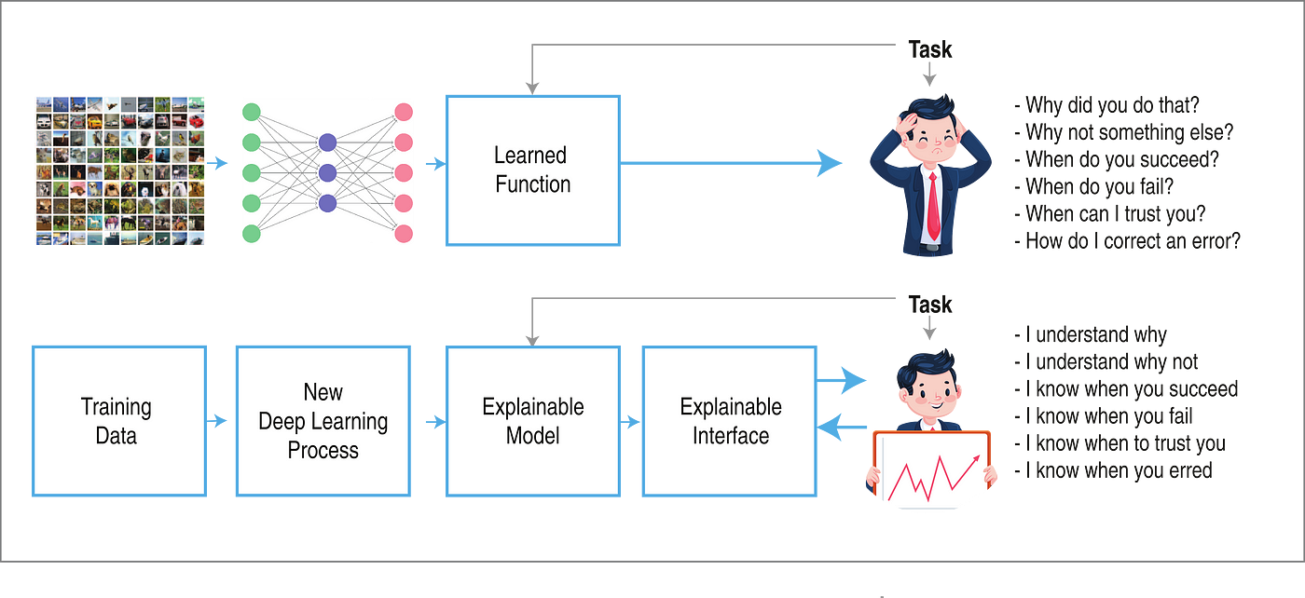
XAI Importance
Notes:
Here is a visualization that shows why explainibilty is important. Above you can see that the person is struggling to trust the outcome of the task as he is not explained how the model came up with the solution. While below you can see that by the use of an explainable interface he can make more informed decisions.

Slide 6
The PROBLEM

Slide 7
The Problem
The way ensemble models aggregate rules is the real problem.
The ensemble classifiers initially create hundreds of different rules.
The rules extracted from individual trees are weighted in some manner(different for each ensembling technique).
The final prediction is made by aggregating the rules e.g. getting the majority vote
Notes:
The challenge with ensemble models is how they combine many different rules. Each model creates hundreds of rules, and then they use a method, like majority voting, to make a final prediction based on those rules."

Slide 8
The Problem (cont.)
This whole aggregation is the real reason why the decision behind the prediction is unclear.
And this is exactly what we try to overcome.
We take hundreds of thousands of rules and simplify them to ONE ; without having to compromise either on specificity or loss of important information
Notes:
This creates a problem in explainibily since there are many many qhich make the decision making process complicated. This is what we are tring to solve by simplifying hundreds of thousands of rules into ONE without compromising on specificity amd loss of important information

Slide 9
Terminology

Slide 10
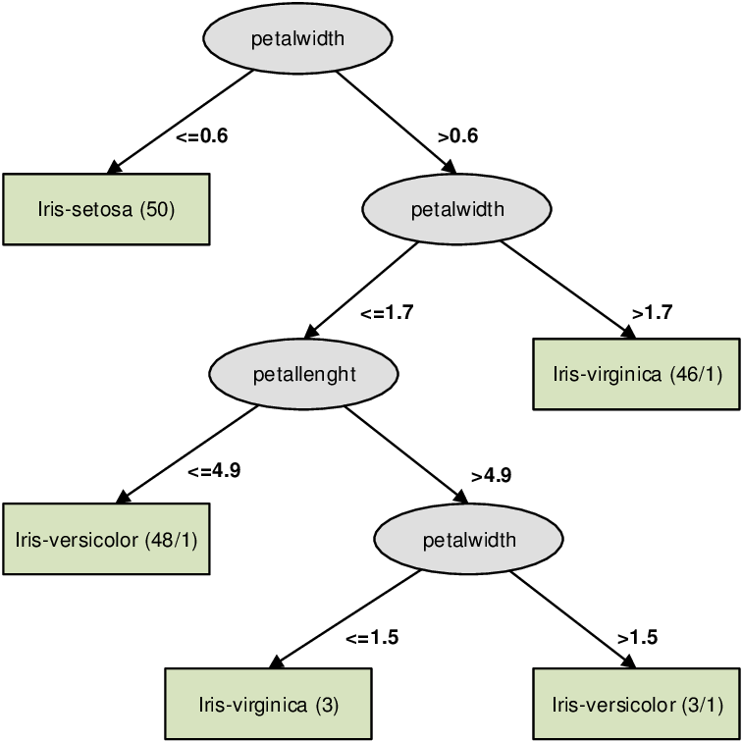
Decision Tree Rule Example
The red region shows an example of how a decision tree creates a rule.
If a test data point has :
petal width > 0.6
AND
petal width > 1.7
→
Class Prediction : Iris Virginica
Sepal Length
Petal Width
Petal Length
Sepal Width
Notes:
A decision tree is a flowchart-like structure used for making decisions or predictions in machine learning.
Structure:
Nodes: Represent decisions/questions about features (e.g., "Is age > 30?")
Branches: Show possible answers ("Yes" or "No")
Leaves: Final decisions/outcomes (e.g., "Buy" or "Not Buy")
Leaves are the lowest nodes in some branch of a tree.

Slide 11
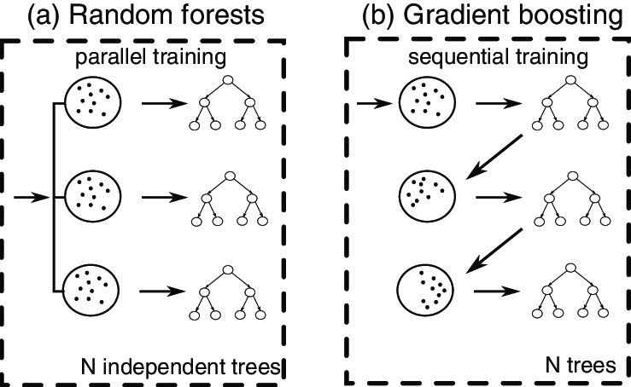
Ensemble Learning Techniques
Notes:
Random forests make many decision trees and combine their results to improve accuracy and prevent overfitting.
Gradient boosting builds trees one after another, with each tree fixing the mistakes of the last one to create a very accurate model

Slide 12
Features , Leaves and Rules
The leaves of each tree are important for us because for reaching a leaf, the data point has to traverse a set of conditions that can be combined to create a rule.
The subclauses of the complete rule are features of the original data that the tree splits the data across.
Each feature is split at some value which is depicted by the comparison operators
Example of Rule Extracted from one tree of Random Forest Classifier
'Tree 0 - Rule 0: if (worst concave points <= 0.144) and (mean texture <= 21.305) and (worst area <= 947.6) and (perimeter error <= 4.032) and (worst compactness <= 0.349)
--> class: benign (proba: 100.0%) | based on 167 samples'

Slide 13
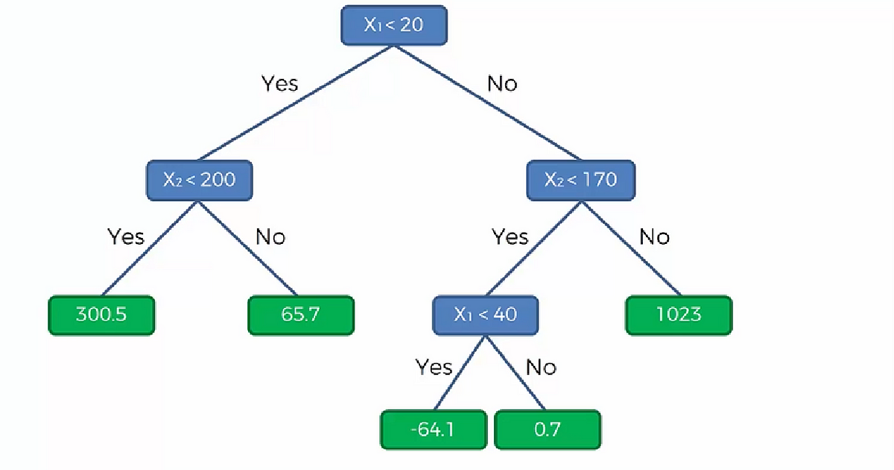
Neighborhood and Neighbors
All of the datapoints that pass a specific rule essentially become a neighborhood.
The close proximity that the data points in a leaf are in can be though of as a neighborhood
The blue arrows depict the path
a set of neighbors(training datapoints)
would take.
N1, N2 …, depict neighborhoods of
leaves of this tree.
N1
N2
N5
N3
N4

Slide 14
SHAP (SHapley Additive exPlanations)
What is SHAP?
SHAP stands for SHapley Additive exPlanations, a popular method for interpreting machine learning models.
It assigns each feature an importance value for a specific prediction, helping to explain how the model makes decisions
Why SHAP?
Transparency: Makes complex models (like Random Forests or Neural Networks) understandable.
Consistency: Ensures that feature importance values are consistent across different models

Slide 15
Methodology

Slide 16
Complete Rule Simplification Procedure
The rule simplification procedure is divided into 3 main parts
Initial Filtering Using SHAP Values
Specific Filtering for Test Data
Final Rule Validation

Slide 17
Initial Filtering using SHAP Values

Slide 18
Initial Filtering
1. Extract Rules from trained ensemble model
2. Find Neighborhoods related to all Rules
3. Updating Rules Bounds Based on Neighborhoods
4. Filtering Features from Rules based on SHAP Importance

Slide 19
1 .Rule Extraction from Ensembles
All the ensemble models had different way of outputting decision trees.
A major challenge was to understand and parse the different data structures in which the trees/forest were outputted by the ensemble libraries.

Slide 20
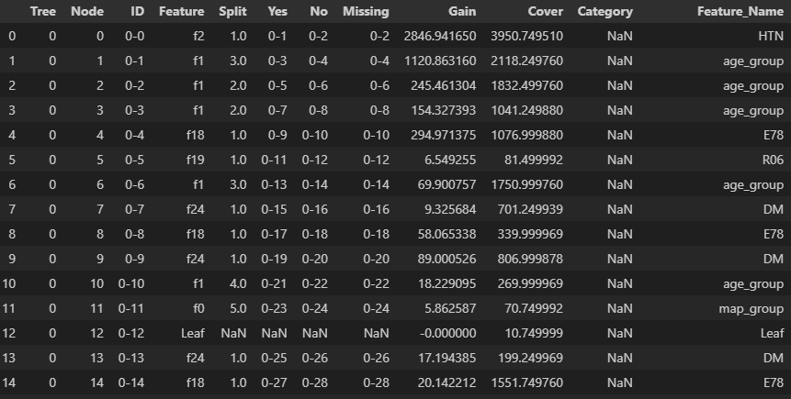
1. Rule Extraction from Ensembles : XGBoost
Xgboost’s booster method allows us to display the decision trees in the following format.
The dataframe can then be parsed to trace back a leaf to the original root and thus create a complete rule.

Slide 21
1. Rule Extraction from Ensembles : LightGBM
Lgbm gives an output of nested dictionaries for each tree.
We recursively checked the nested dictionaries in a Depth First Search manner, keeping track of features, split values and left /right children.

Slide 22
1. Rule Extraction from Ensembles: RandomForest
The code for extracting these rules was available online.
The sci kit learn library has a skelarn.tree_ method that outputs the complete tree in a specific text format.
All we needed to do was parse the text and get rules from each tree.

Slide 23
2. Finding Neighborhoods
For each leaf in all of the ensemble forest, check which data points from the train dataset pass the rules corresponding to that leaf.
This is helpful in getting a sense of which data points are similar in their features.

Slide 24
3. Updating rules based on the Neighborhood
Based on neighborhood data, the original rule is modified by bounding features with min and max values from the data points.
This ensures that the updated rules better reflect the actual data distribution
Example
OrderedDict([('worst concave points', {'max': 0.1427, 'min': 0.0}), ('mean texture', {'max': 21.28, 'min': 9.71}), ('worst area', {'max': 932.7, 'min': 185.2}), ('perimeter error', {'max': 4.021, 'min': 0.757}), ('worst compactness', {'max': 0.3441, 'min': 0.02729})])

Slide 25
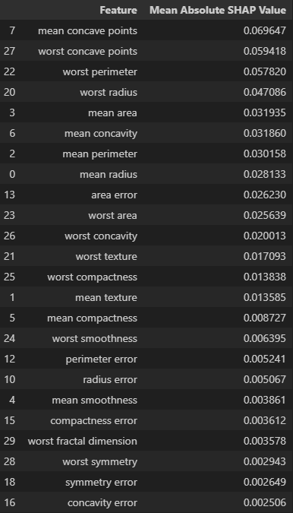
Calculating SHAP Importance Values
The higher the number the more important the feature in the classification procedure.
Some values are negative and indicate the importance of a feature for the negative class.
Therefore we take the mean absoulte value of original values as the final cnsideration.

Slide 26
4. Updating Rules from SHAP Values
Based on a specific threshold, select only the features that pass a specfic threshold. (the threshold can be adjusted manually)
Original Rule_dict
OrderedDict([('worst concave points', {'max': 0.1427, 'min': 0.0}), ('mean texture', {'max': 21.28, 'min': 9.71}), ('worst area', {'max': 932.7, 'min': 185.2}), ('perimeter error', {'max': 4.021, 'min': 0.757}), ('worst compactness', {'max': 0.3441, 'min': 0.02729})])
Modified after SHAP filtering
OrderedDict([('worst concave points', {'max': 0.1427, 'min': 0.0}), ('mean texture', {'max': 21.28, 'min': 9.71}), ('worst area', {'max': 932.7, 'min': 185.2})]

Slide 27
Specific Filtering for Test Data

Slide 28
Rule Filtering and Aggregation Specific for Test Data
The aggregation process can be conducted in many different ways
Our approach attempted to leverage the neighborhoods and its inhabitants in which test data belonged to.
This way only the features that were important in classification of test data would be part of the final aggregated rule.

Slide 29
Specific Filtering for Test Data
1. Find Neighborhoods in which Test Point Belongs
2. Find all Training Data Points in those Neighborhoods
3. Aggregate All the features into a Single Rule
4. Update aggregated rule feature bounds based on the Training Data
5. Get the top occurring features from each rule
6. Include only the top most occurring features in the final rule

Slide 30
1. Finding Neighborhoods in which the Test Data Point Belongs
For the unseen datapoint, check which of the updated rules it passes.
This would give us the location of the neighborhoods the data point belongs into.
From all the neighborhood locations, lookup the rules from the complete rule base.

Slide 31
2. Aggregating the Rules for the Test Data Point
Combine all the rules from the test data point neighborhoods into a single rule.
Rule features have their bounds updated by the min and max values present of the data points belonging to the neighborhoods.

Slide 32
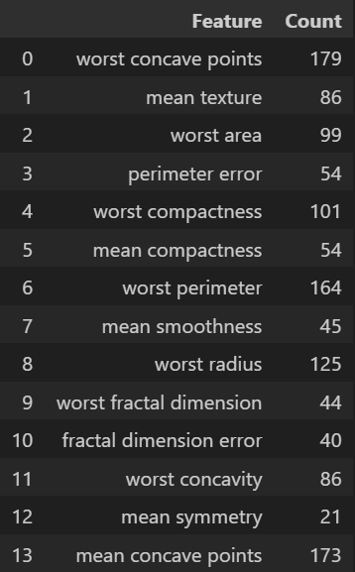
Picking Top X Features from the Aggregated Rule
Checking which features appear the most in all of the rules
Select the top X number of features based on your preference.
This choice will determine the length of the final rule: a lower number offers easier explainability, while a higher number provides more detail and precision

Slide 33
Final Rule Validation

Slide 34
Final Rule Validation
After getting the final rule we have to validate it.
The idea behind it is that we want to ensure that before displaying the final result we have an idea whether our customized rule is specific enough for out test data and does not lose much important information during the simplification.

Slide 35
Final Rule Validation
1. Find Train data points which pass our customized rule.
2. Use the trained ensemble model to predict on those data points
3. Calculate the percentage of each predicted class

Slide 36
1. Finding all training data points which pass our customized rule
The percentage of training data points that pass our rule will indicate whether our rule was very generic or not.
A lot of data points passing the rule would indicate that our rule was very general and it did capture the fine details.

Slide 37
2. Get predictions from trained Model
The trained ensemble model predicts on the collected data points that pass our customized rule.
It either predicts a positive or negative class for each data point.

Slide 38
3. Calculating Percentage of Predicted Classes
The percentages of the predicted classes will indicate whether our rule was specific towards one class or the other.
A high percentage would be indicative that our rule was specific enough to not capture irrelevant features.

Slide 39
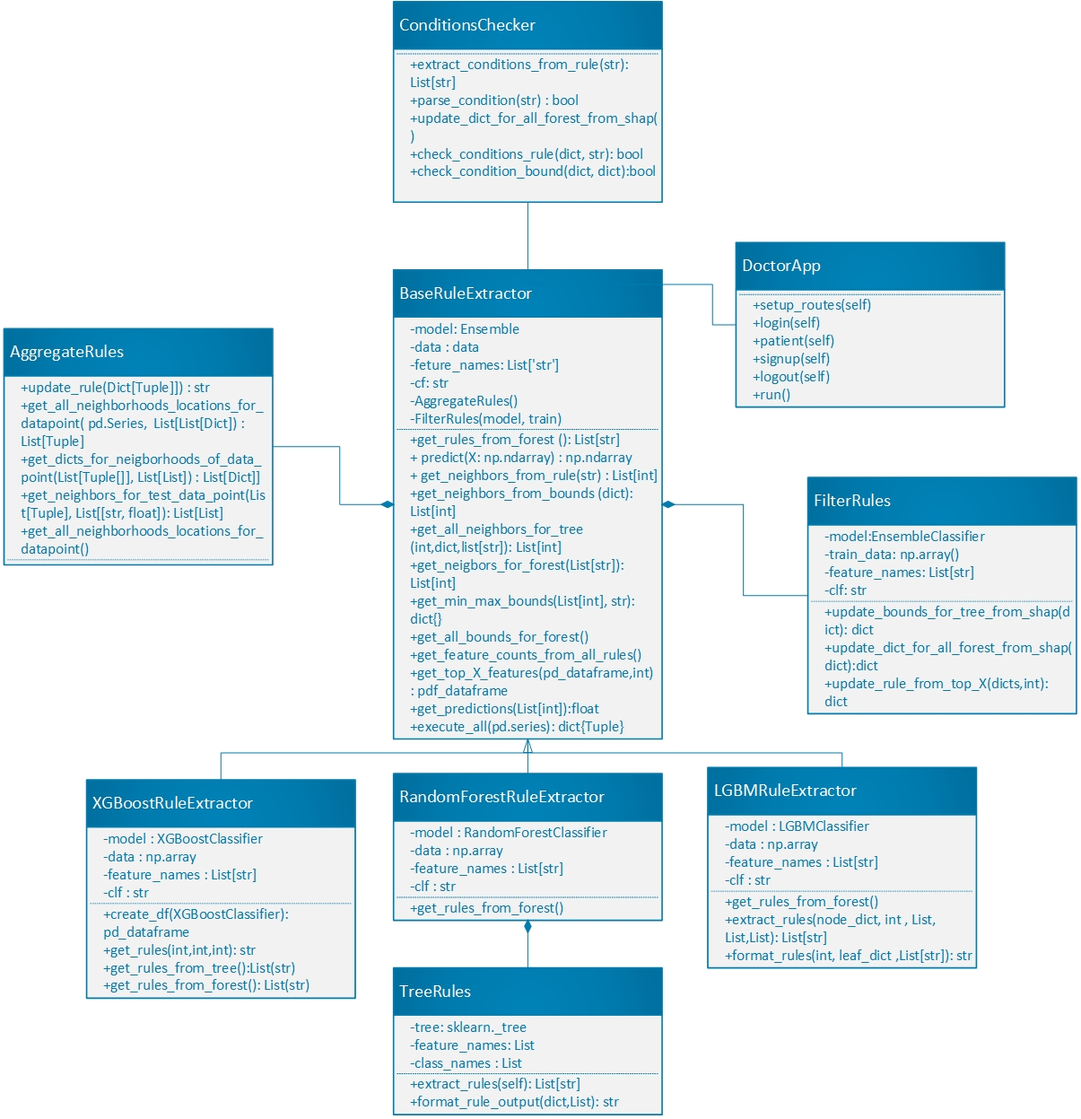
Class Diagram

Slide 40
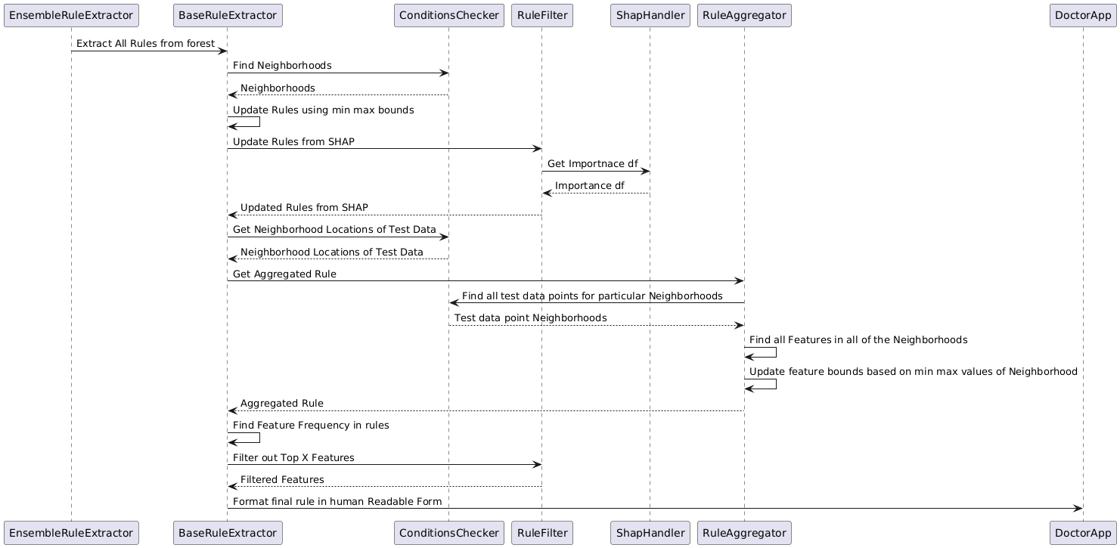
Sequence Diagram

Slide 41


Front End
To display the functionality of our library, we created a user-friendly frontend using HTML and CSS which we connected to our python library by calling it in our Flask app.
Frontend development
Web development framework

Slide 42
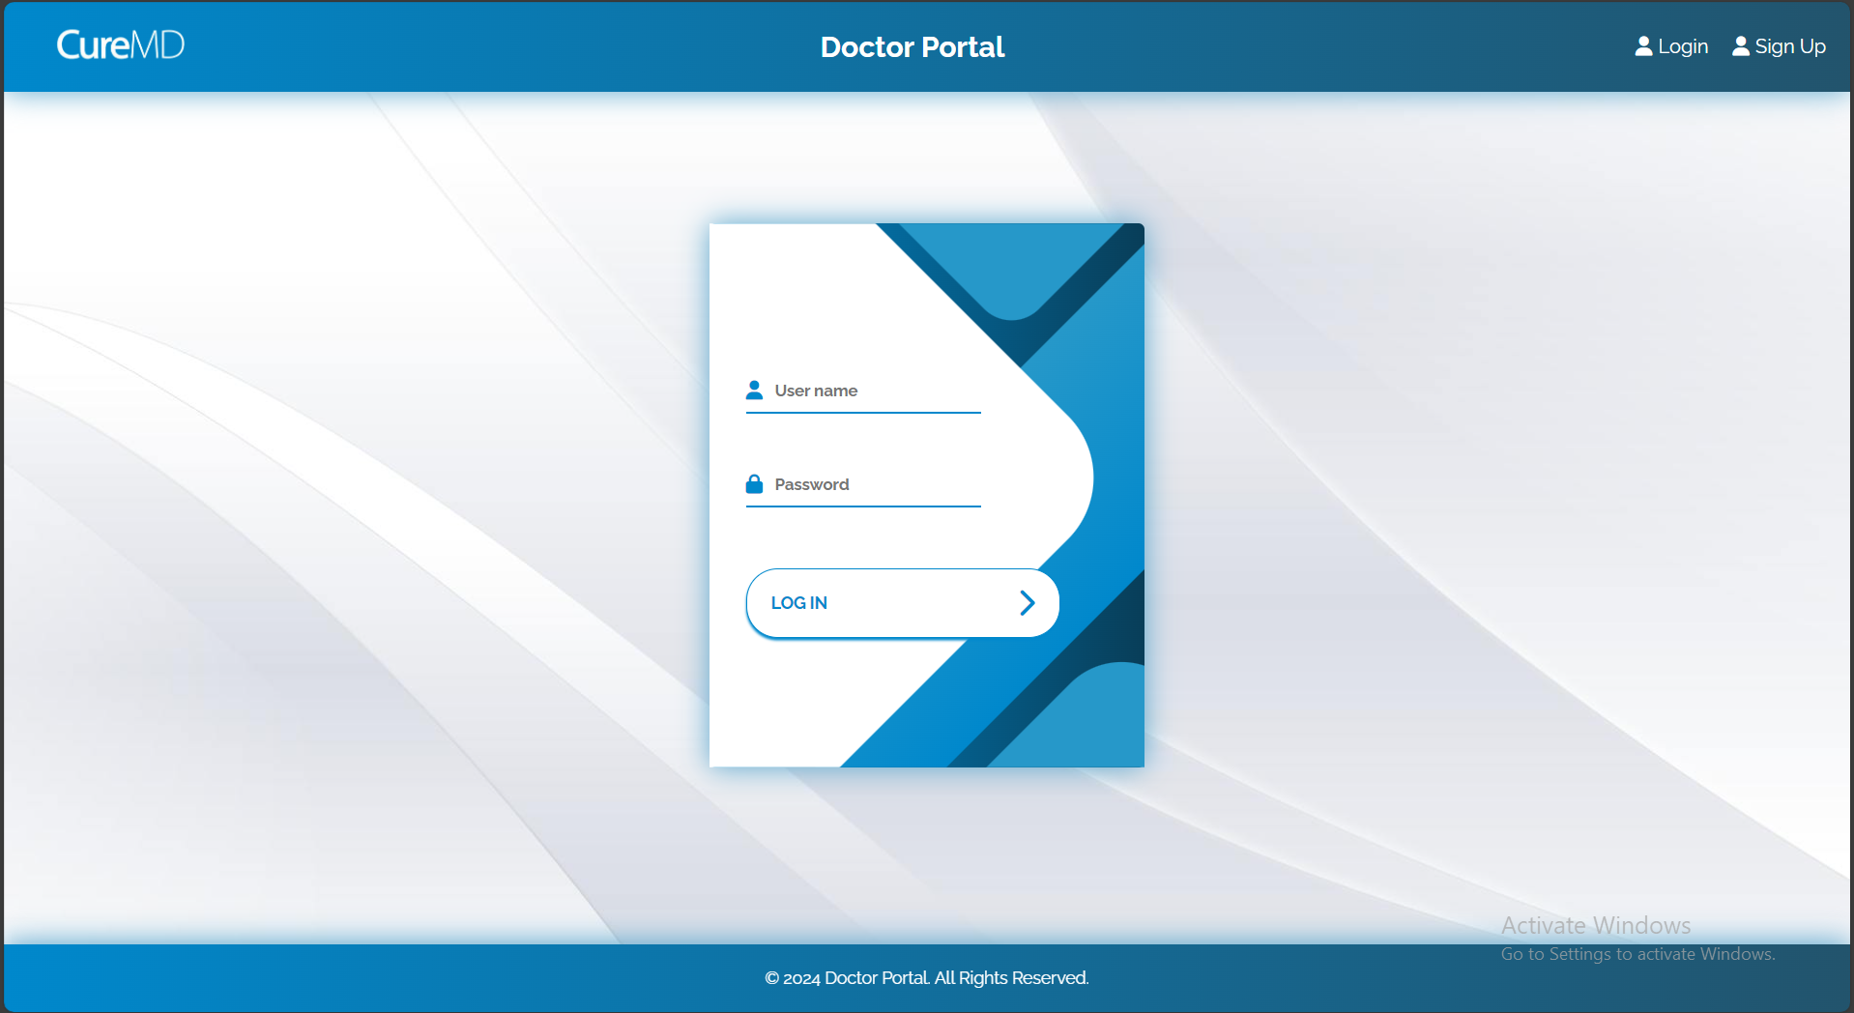
Login/Signup Page
Login/Signup page for verified access for only Doctors to sensitive patient information.

Slide 43

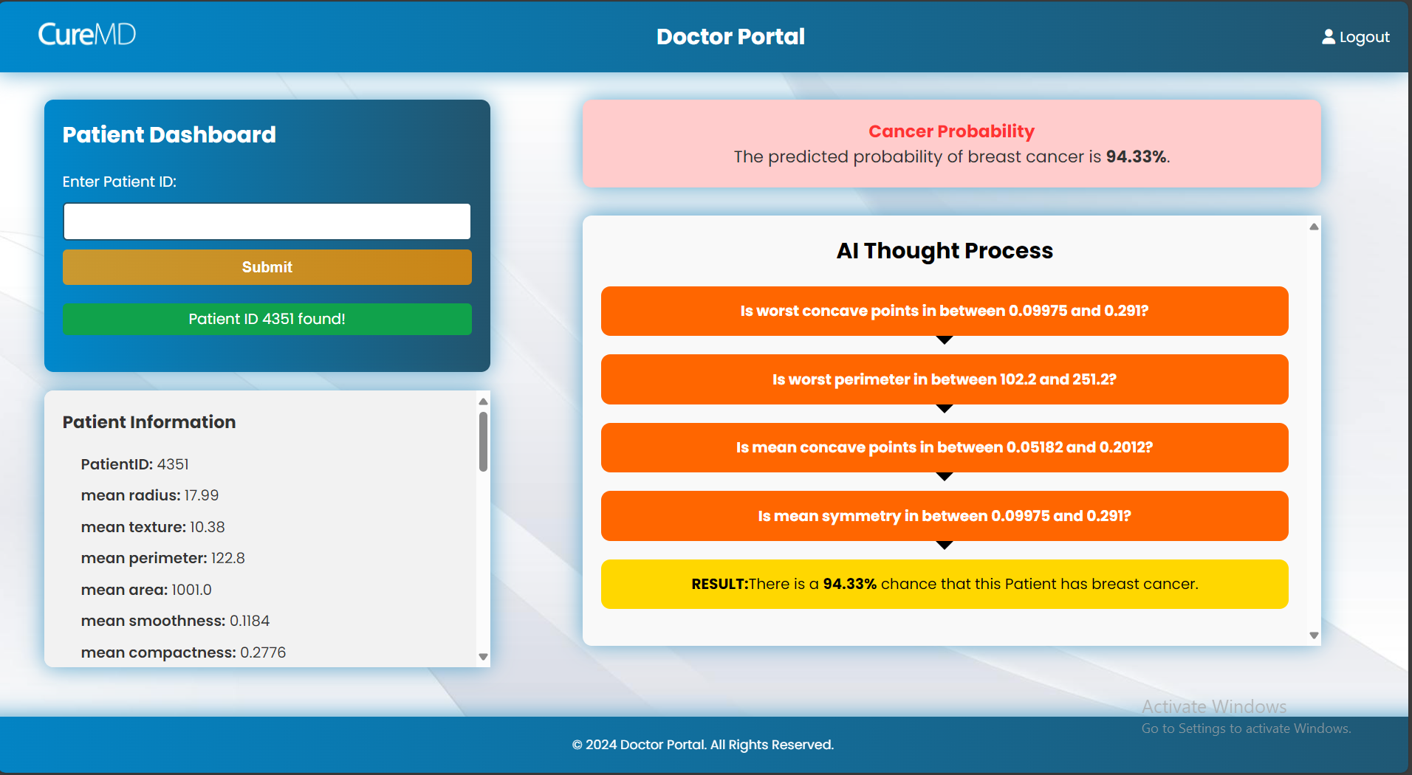
Doctor’s Dashboard
A dashboard that verifies if a Patient’s data is available, runs the model and extracts the rules to showcase to the Doctor the AI models thought process.

Slide 44
Results

Slide 45
Results
An initial experiment was set up on the breast cancer dataset.
The dataset has 30 different features all having numerical values.
The dataset has 569 individual samples.
Top 5 features were selected from the final feature frequency based filtering

Slide 46
Experiment
Ensemble | No. of Estimators | Initial Extracted Rules | Percentage of Train Data points in Final Rule(%) | Percentage of Correct Predictions in the New Rule
Random Forest | 100 | 2119 | 36.2 | 100
LightGBM | 100 | 2274 | 60 | 92.1
XGBoost | 100 | 653 | 36.5 | 98.2

Slide 47
Triple Extraction Evaluation
Demo

Slide 48
Triple Extraction Evaluation
Future Work

Slide 49
Future Work
The library works for 3 ensemble models only.
The extraction is limited for binary classification

Slide 50
Thank You

